Slide 1

Cerberus：A Multi-Headed Derenderer
Boyang Deng, Simon Kornblith, and Geoffrey Hinton
Google Brain, Toronto

Slide 2
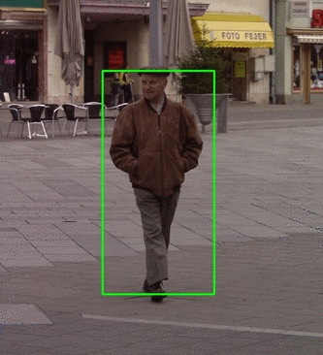
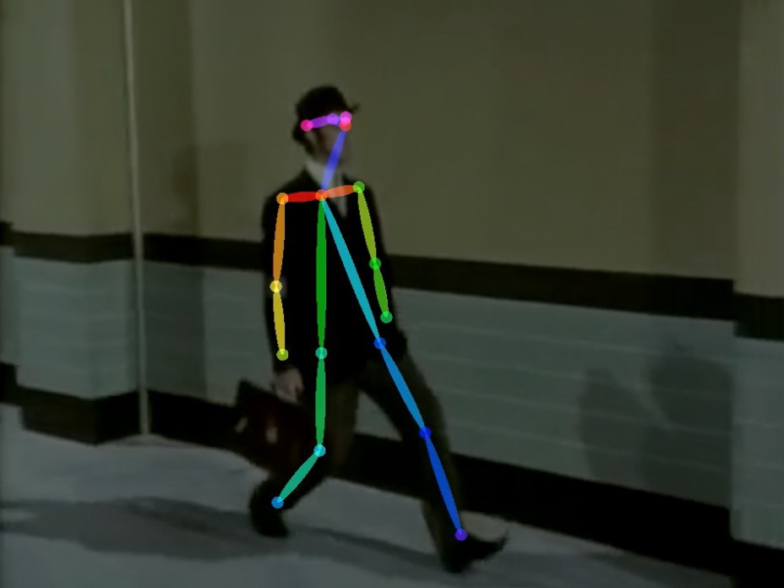
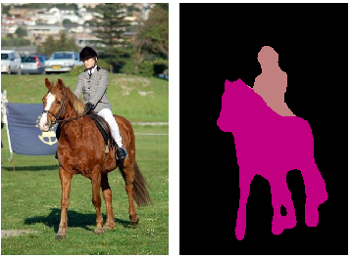
Modeling objects in images
2D Representation?

Slide 3
Modeling objects in images
2D Representation?
Not enough, because a lot of objects, e.g. animals, are inherently 3D.

Slide 4
Modeling objects in images
2D Representation?
Not enough, because a lot of objects, e.g. animals, are inherently 3D.
2D means a hard time for novel viewpoints and novel lightings, especially in generation.

Slide 5
Modeling objects in images
2D Representation?
Not enough, because a lot of objects, e.g. animals, are inherently 3D.
2D means a hard time for novel viewpoints and novel lightings, especially in generation.
And …… this is a 3D Vision workshop.

Slide 6
Modeling objects in images
2D Representation? Not Enough.

Slide 7
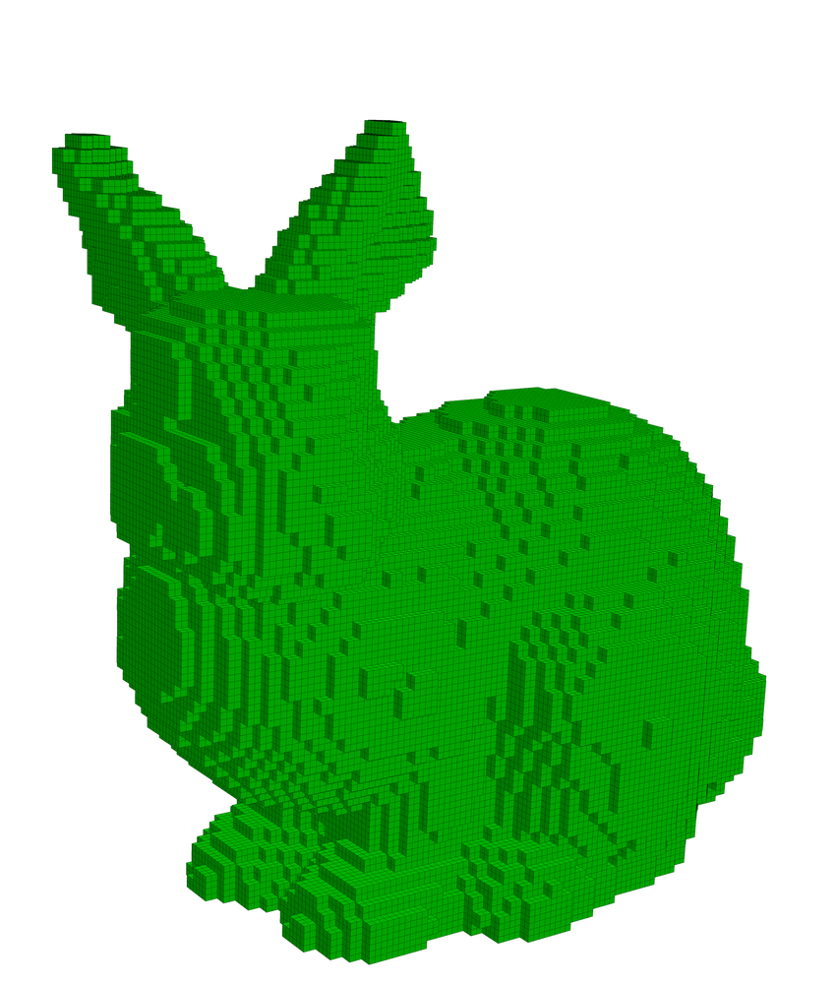
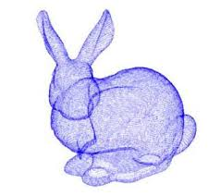
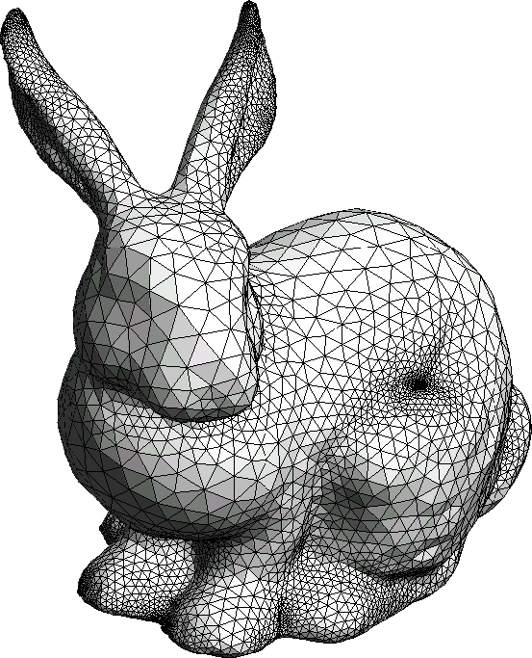
Modeling objects in images
2D Representation? Not Enough.
3D Representation?

Slide 8
Modeling objects in images
2D Representation? Not Enough.
3D Representation?
Good. Representing objects as they are.

Slide 9
Modeling objects in images
2D Representation? Not Enough.
3D Representation?
Good. Representing objects as they are.
Friendly to re-rendering under novel scenes. Thanks to Graphics.

Slide 10
Modeling objects in images
2D Representation? Not Enough.
3D Representation?
Good. Representing objects as they are.
Friendly to re-rendering under novel scenes. Thanks to Graphics.
Which one to use? Voxel, point cloud, or mesh.

Slide 11
Modeling objects in images
2D Representation? Not Enough.
3D Representation?
We choose mesh.
Compact compared to voxel.
Fast rasterization -> Plug a differentiable renderer in training -> No 3D supervision.

Slide 12
Modeling object in images
2D Representation? Not Enough.
3D Representation? Mesh.
Mesh for Articulated Bodies
Previous methods^{[1, 2]} use a single mesh with fixed topology.
Articulated bodies have poses, i.e. relative locations and orientations of parts.
[1] Kato, Hiroharu, Yoshitaka Ushiku, and Tatsuya Harada. "Neural 3d mesh renderer." Proceedings of the IEEE Conference on Computer Vision and Pattern Recognition. 2018.
[2] Wang, Nanyang, et al. "Pixel2mesh: Generating 3d mesh models from single rgb images." Proceedings of the European Conference on Computer Vision (ECCV). 2018.

Slide 13
Modeling object in images
2D Representation? Not Enough.
3D Representation? Mesh.
Mesh for Articulated Bodies
Previous methods^{[1, 2]} use a single mesh with fixed topology.
Articulated bodies have poses, i.e. relative locations and orientations of parts.
Single mesh is hard to fit various poses.
[1] Kato, Hiroharu, Yoshitaka Ushiku, and Tatsuya Harada. "Neural 3d mesh renderer." Proceedings of the IEEE Conference on Computer Vision and Pattern Recognition. 2018.
[2] Wang, Nanyang, et al. "Pixel2mesh: Generating 3d mesh models from single rgb images." Proceedings of the European Conference on Computer Vision (ECCV). 2018.

Slide 14
Modeling object in images
2D Representation? Not Enough.
3D Representation? Mesh.
Mesh for Articulated Bodies
Previous methods^{[1, 2]} use a single mesh with fixed topology.
Articulated bodies have poses, i.e. relative locations and orientations of parts.
Single mesh is hard to fit various poses.
Solution: A Part-based Model.
[1] Kato, Hiroharu, Yoshitaka Ushiku, and Tatsuya Harada. "Neural 3d mesh renderer." Proceedings of the IEEE Conference on Computer Vision and Pattern Recognition. 2018.
[2] Wang, Nanyang, et al. "Pixel2mesh: Generating 3d mesh models from single rgb images." Proceedings of the European Conference on Computer Vision (ECCV). 2018.

Slide 15
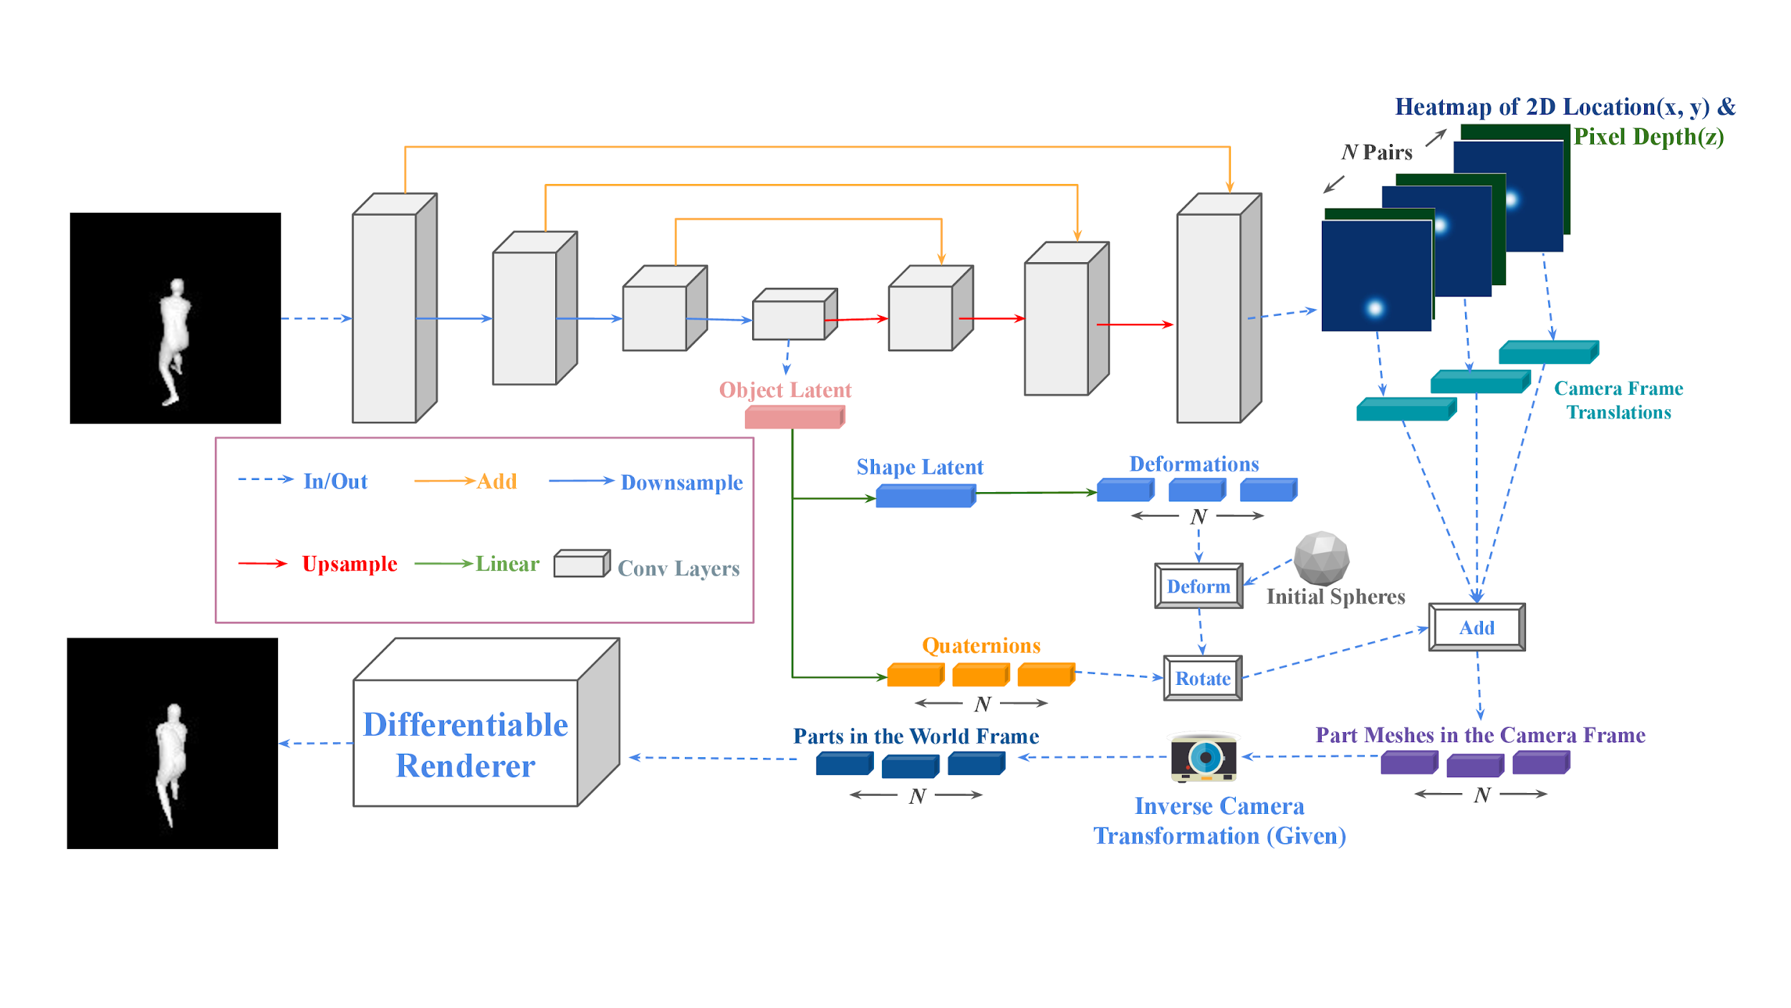
Cerberus: A Multi-headed Derenderer

Slide 16
Cerberus: A Multi-headed Derenderer
Image Encoding
(Image -> Latent Vector + Heatmaps + Depth maps)
Notes:
Heatmap/Depthmap are for getting (x, y, z) coordinates of each parts.

Slide 17
Cerberus: A Multi-headed Derenderer
Mesh Generation:
Latent -> Transformed Meshes

Slide 18
Cerberus: A Multi-headed Derenderer
Differentiable Mesh Rendering

Slide 19
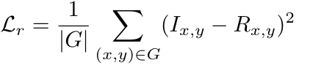
Cerberus: A Multi-headed Derenderer
Reconstruction Loss
Notes:
MSE loss/Recon loss.

Slide 20
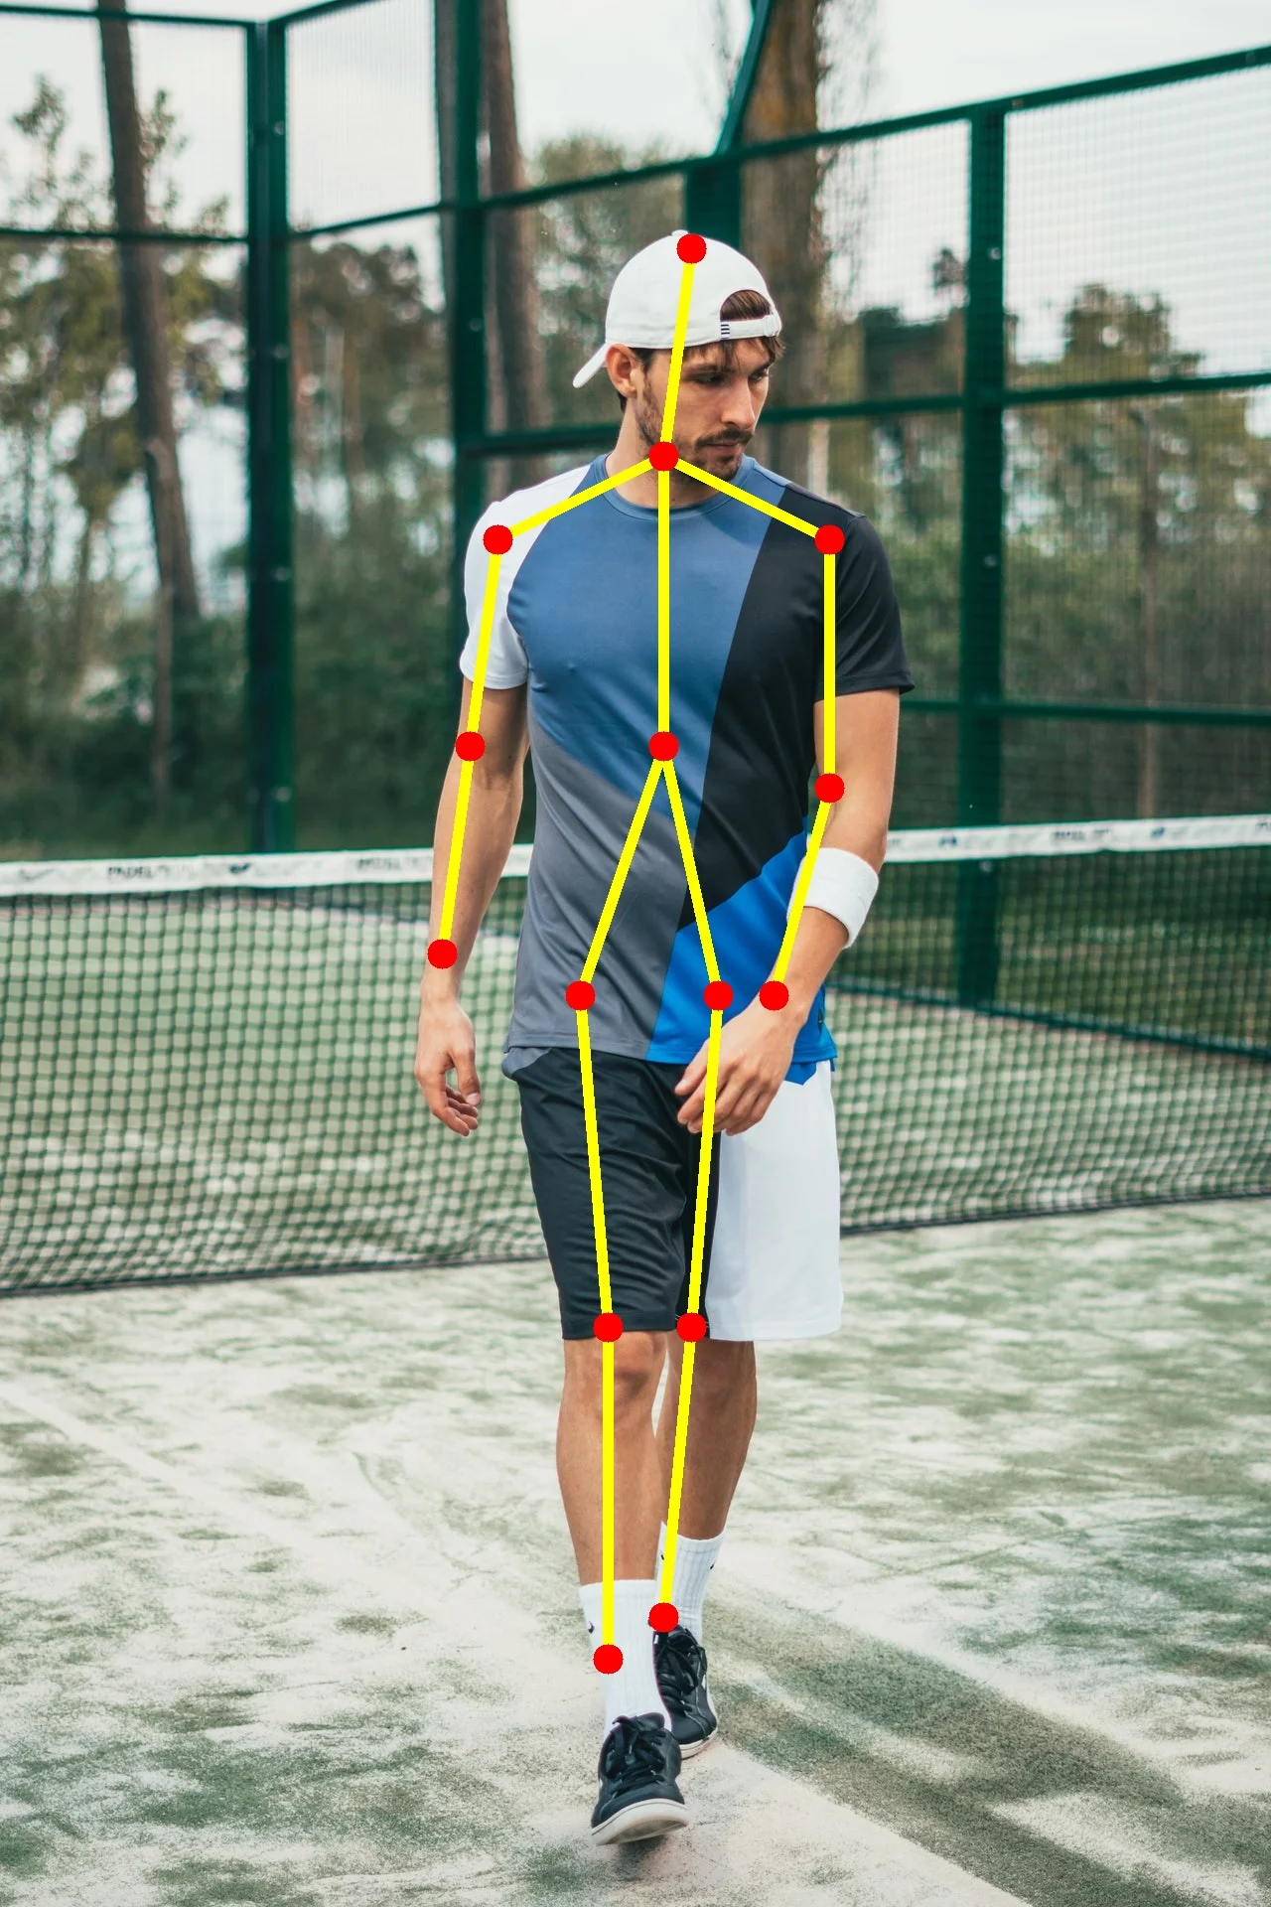
How to learn parts?
With supervision (e.g. keypoints) -> Easy. Add a loss term.

Slide 21
How to learn parts?
With supervision (e.g. keypoints) -> Easy. Add a loss term.
Can we learn parts without part annotations?

Slide 22
How to learn parts?
With supervision (e.g. keypoints) -> Easy. Add a loss term.
Can we learn parts without part annotations? Yes.
Let’s rethink the properties of parts.

Slide 23
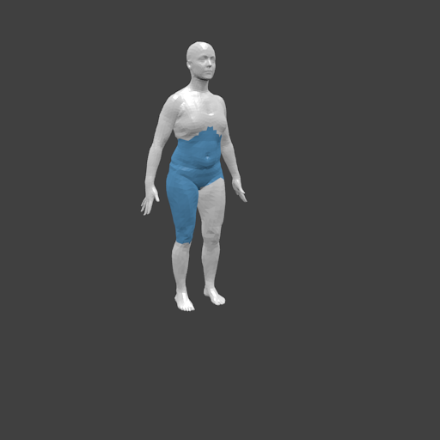

How to learn parts?
Part Split No.1
Part Split No.2

Slide 24
How to learn parts?
No.2 is preferred
Why?
Part Split No.1
Part Split No.2
Notes:
Splition -> Partitioning/Split

Slide 25
How to learn parts?
No.2 is preferred
Why?
Pose Consistency
Part Split No.1
Part Split No.2

Slide 26
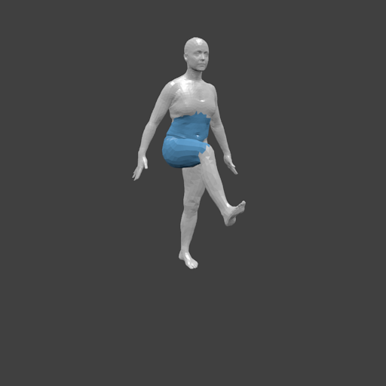

How to learn parts?
Wrong Parts
Pose:
Change
Part shapes:
Change
Part Split No.1

Slide 27

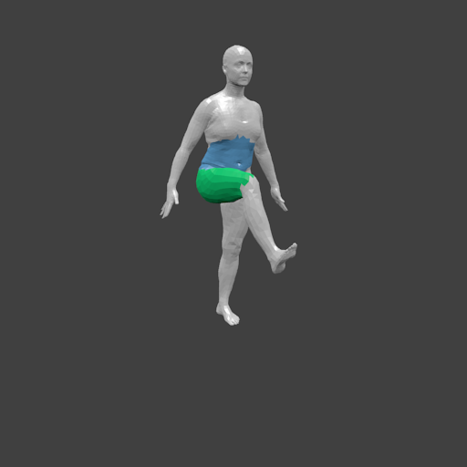
How to learn parts?
Right Parts
Pose:
Change
Part shapes:
No Change
Part Split No.2

Slide 28
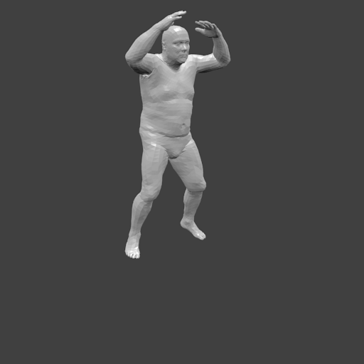
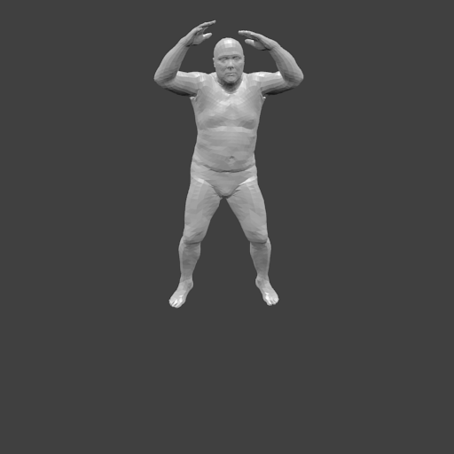
Another consistency
Viewpoint
Consistency
Viewpoint:
Change
3D Model:
No Change
Viewpoint Consistency

Slide 29
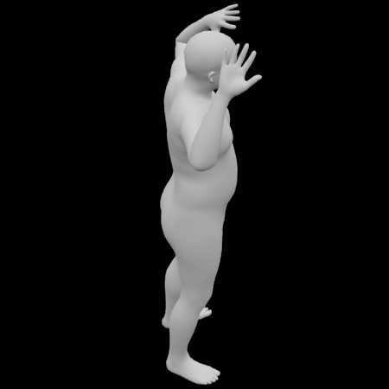
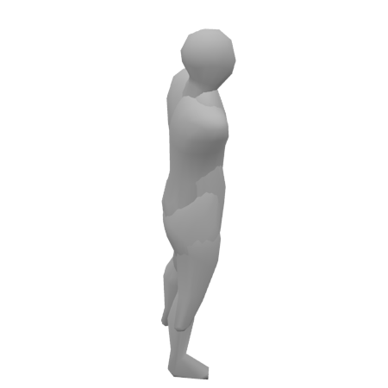
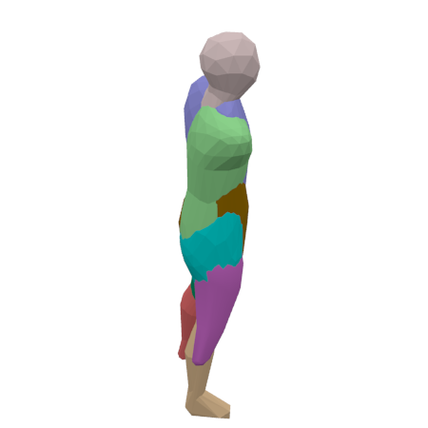
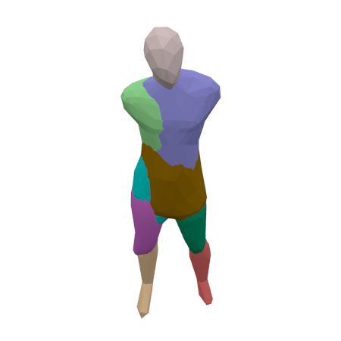
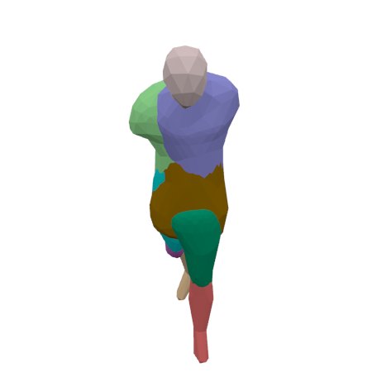
Results
Input
Output
Parts
New Viewpoint
New Pose

Slide 30
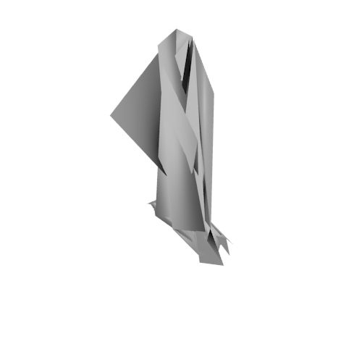
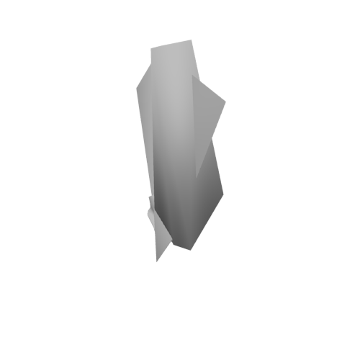
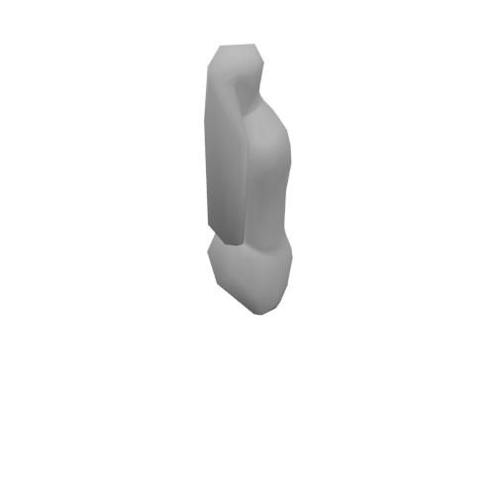
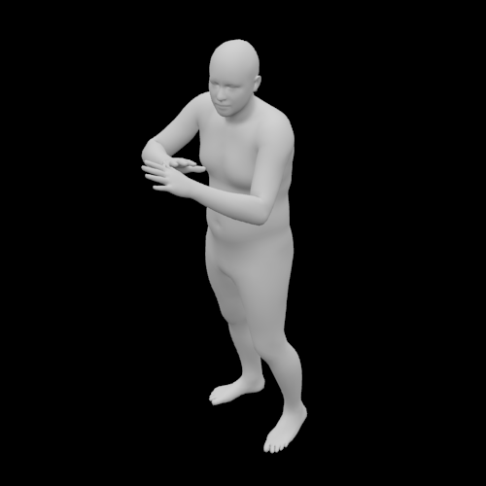
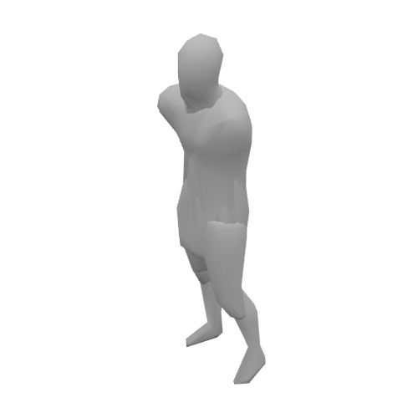
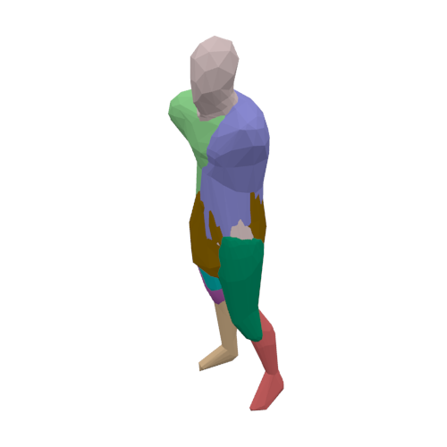
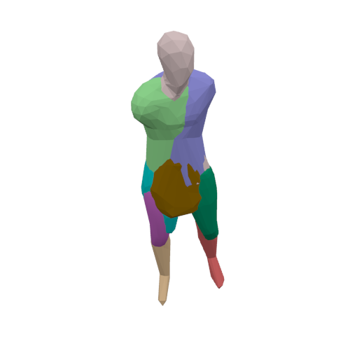
Results: Human Dataset*
NMR is Neural Mesh Renderer.
NMRs is NMR with smooth loss.
NMRr is NMR with our differentiable Renderer
NMR
NMRs
NMRr
Input
Ours
Our Parts
Our Turn
*The dataset is credit to Angjoo’s project(https://github.com/akanazawa/hmr) and SMPL model from MPII (http://smpl.is.tue.mpg.de/)

Slide 31
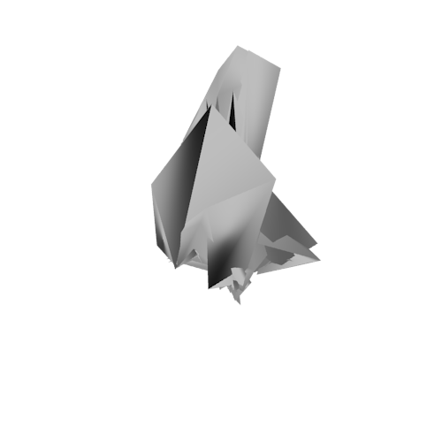
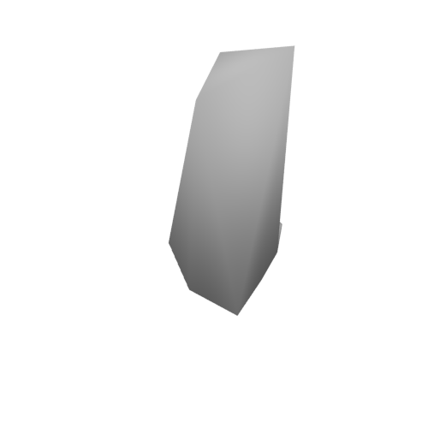
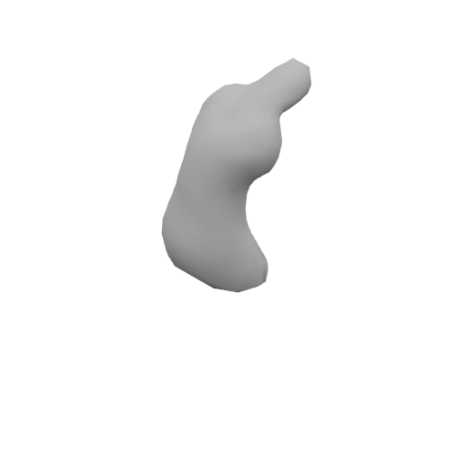
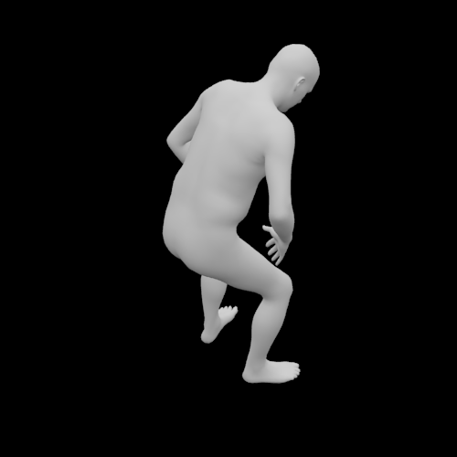
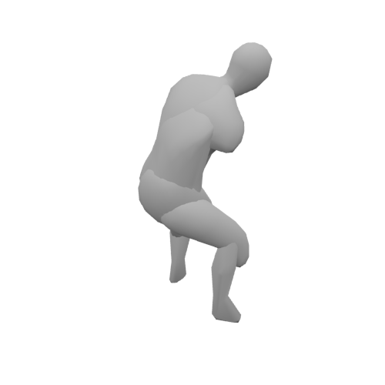
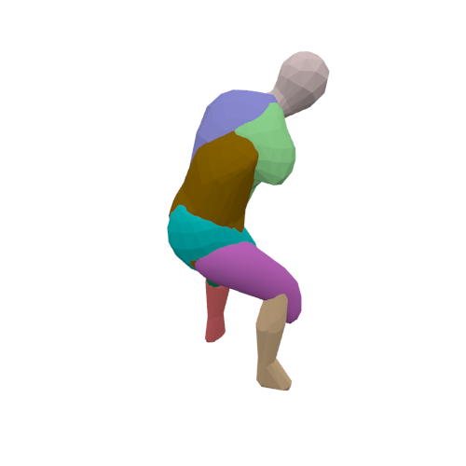
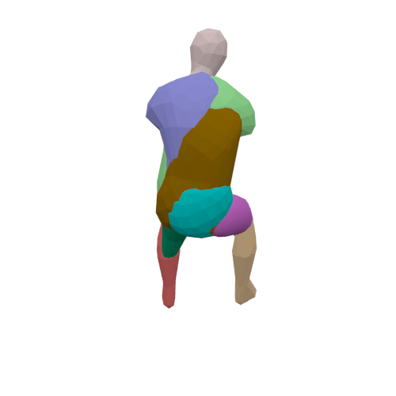
Results: Human Dataset*
NMR is Neural Mesh Renderer.
NMRs is NMR with smooth loss.
NMRr is NMR with our differentiable Renderer
NMR
NMRs
NMRr
Input
Ours
Our Parts
Our Turn
*The dataset is credit to Angjoo’s project(https://github.com/akanazawa/hmr) and SMPL model from MPII (http://smpl.is.tue.mpg.de/)

Slide 32
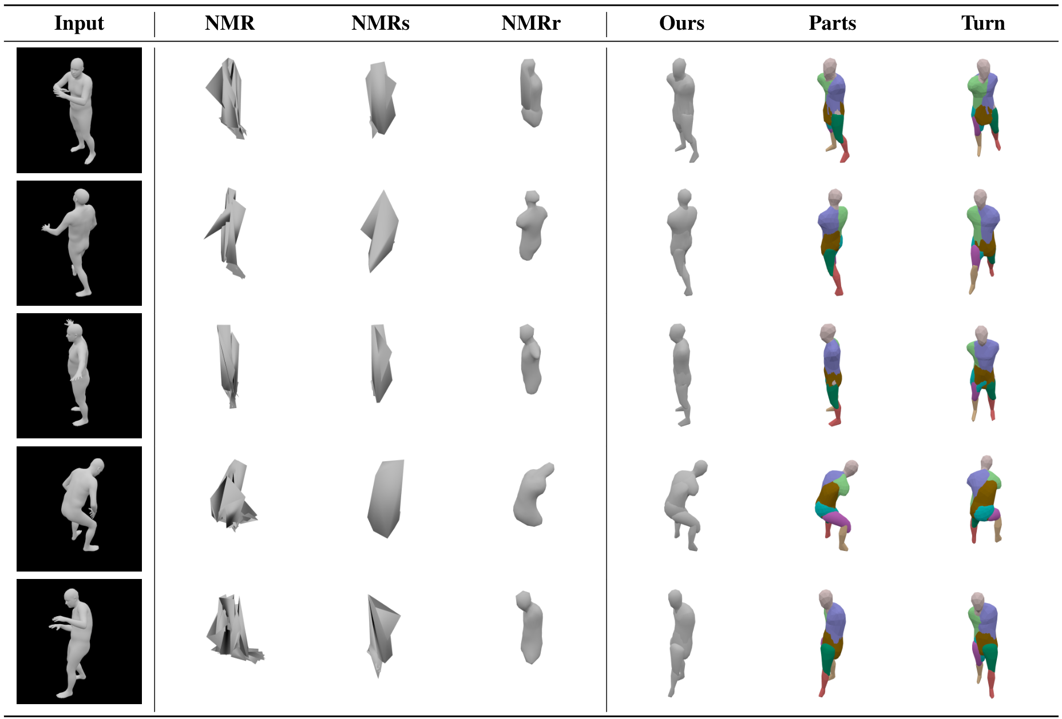
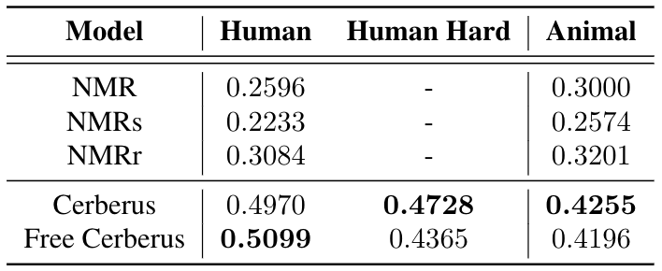
Results: Human Dataset
Free Cerberus is Cerberus without pose consistency.
Cerberus is better than baselines both quantitatively and qualitatively.

Slide 33
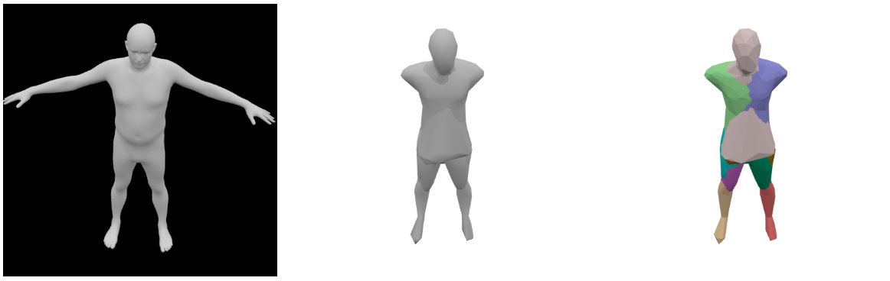
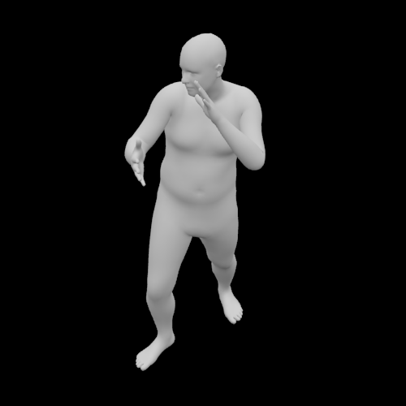
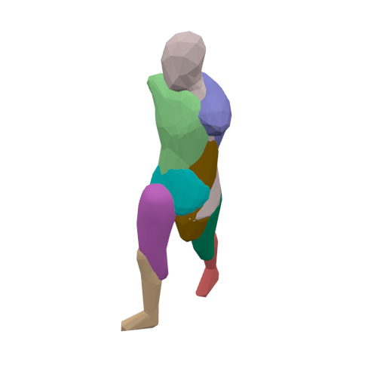
Results: Evaluate parts quantitatively
Part shapes
Transformations

Slide 34
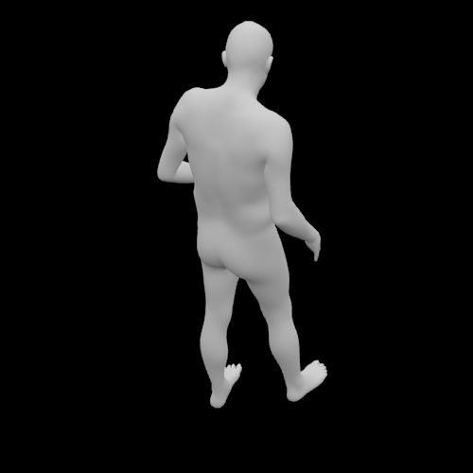
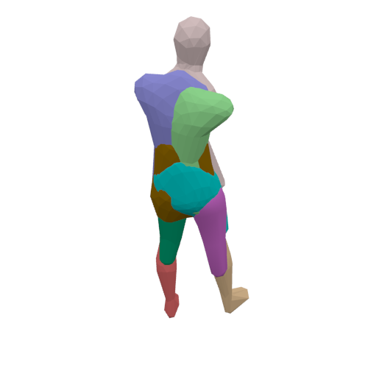
Results: Evaluate parts quantitatively
Part shapes
The performance of Cerberus doesn’t drop much on the hard test.
Pose consistency can help learn better parts.
Transformations

Slide 35
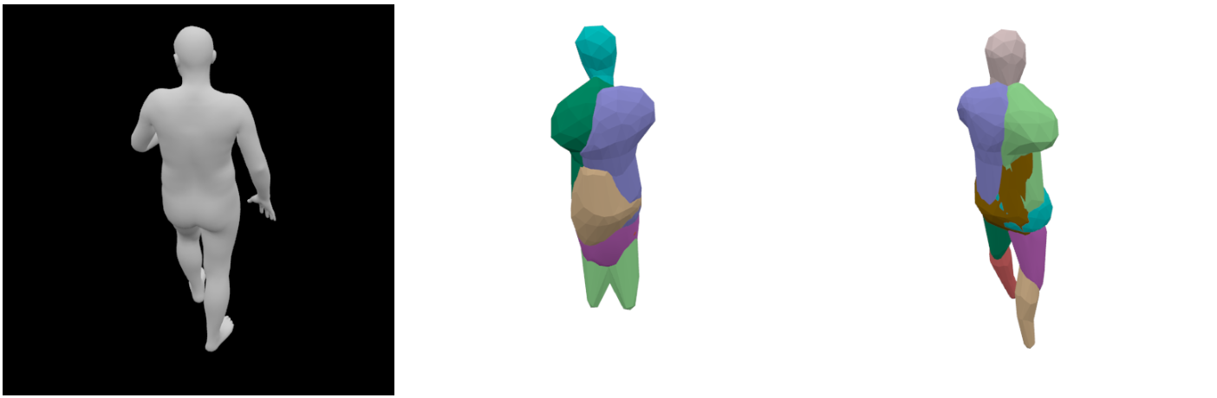
Results: Evaluate parts quantitatively
Input
Free Cerberus
Cerberus
The performance of Cerberus doesn’t drop much on the hard test.
Pose consistency can help learn better parts.

Slide 36
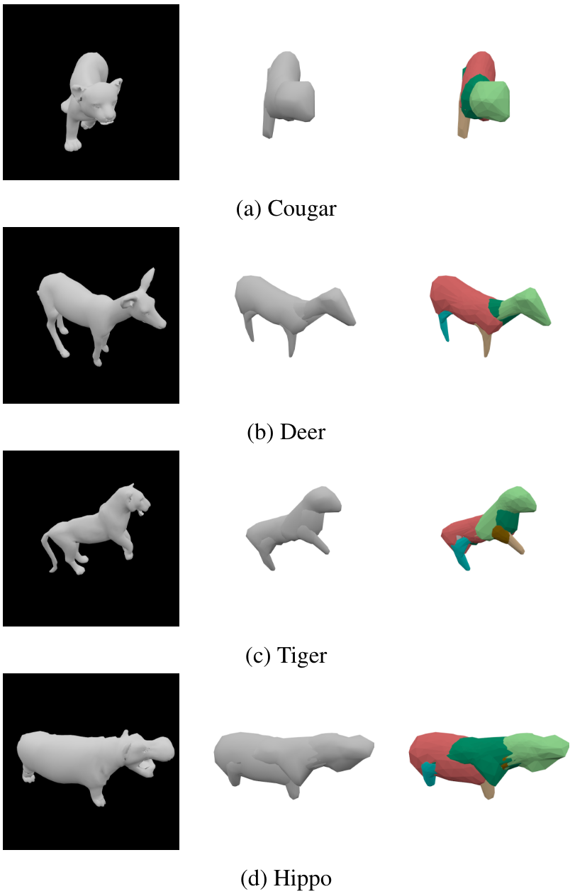
Results: Animal Dataset* (Higher Shape Variance)
Cerberus is consistently better than baseline methods.
*The dataset is credit to SMAL from MPII.

Slide 37
Summary
We present Cerberus, a 3D perception framework for articulated bodies.
We present consistency constraints for learning parts without part supervision.
Cerberus, trained with the proposed constraints, outperforms baselines on both standard and hard tests.

Slide 38
Thank you for listening!

